Slide 1
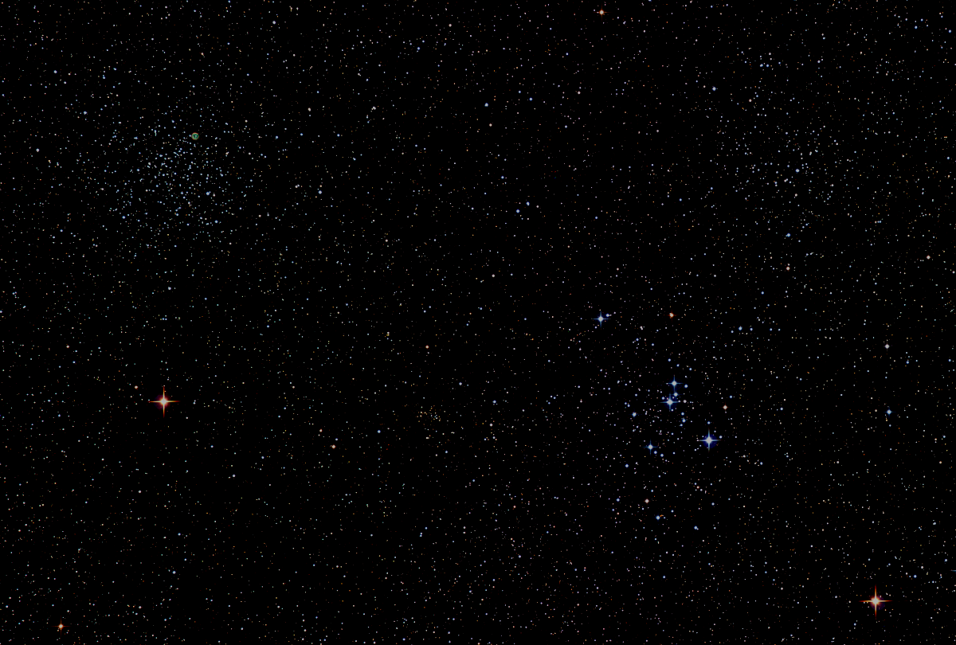

Howard
Astronomical
League
17
April 19th, 2018
Notes:
Howard Astronomical League, Oct 19, 2017

Slide 2
Introductions

Slide 3
Upcoming Events
HAL Events – Alpha Ridge Park
April 21st at 7:30 – Public Star Party
May 12 at 8:00 – Members’ Star Party
Other Events
April 21st – GreenFest at HCC
April 21, 22 – NEAF, Suffern, NY
May 6-13 – Texas Star Party
(Will it be rained out by the Eta Aquarid meteor shower?)
May 10-13 – Star Gaze XXV (DE)

Slide 4
From Dennis Conti
Can’t be with us tonight because he is in NY speaking at NEAC and NEAF
He was invited to Cape Kennedy for an exciting TESS launch last night - flawless so far
“A new era now in exoplanet discovery!”

Slide 5
Three Oppositions in 79 Days!
Jupiter: May 8th
Saturn: June 27th
Mars: July 27th

Slide 6
Venus
15 Aug – Dichotomy (Half phase)
17 Aug – Greatest elongation east
25 Sep – Greatest brightness
26 Oct – Inferior solar conjunction

Slide 7
Member/Usage Stats
Members: 201 Memberships: 268
Yahoo Group: 398 Facebook: 354
Web Traffic
(Yep, we’re world-wide!)
Country | Pages | Hits | Bandwidth
US | 4,855 | 19,1666 | 2.57 GB
Russia | 324 | 509 | 26.18 MB
Gr. Britain | 183 | 278 | 1.36 GB
France | 174 | 260 | 1.41 GB
Ukraine | 145 | 145 | 3.70 MB
Italy | 120 | 300 | 22 GB
Germany | 97 | 121 | 23.27 MB
Netherlands | 79 | 113 | 3.97 MB
China | 77 | 187 | 3.97 MB

Slide 8
Observatory Report
Joel Goodman

Slide 9
This Evening’s Speaker
Dr. Patrick Peplowski
JHU APL, Space Exploration Sector
MESSENGER at Mercury:
New Views of the Innermost Planet
Notes:
It is my distinct pleasure to introduce Dr. Bindu Rani. She has been a Postdoctoral Fellow at NASA/Goddard Space Flight Center since July 2016, and will continue to hold that post until June 2019. She was also a Postdoctoral Fellow at the Max-Planck-Institut für Radioastronomie Bonn, Germany from February 2014 to June 2016. She has held visiting scientist and researcher positions at the Korean Very Long Baseline Interferometry Network of the Korea Astronomy and Space Science Institute, and The Gra-dig-nan Bordeaux Nuclear Research Center in France. Dr. Rani has experience in Gamma-ray, X-ray, optical, and radio astronomy. Her optical observational experience includes use of the 1.04 meter telescope at AIRES, Na-in-i-tal, India, and the 1.20 meter telescope at Mount Abu, India.
Among her many achievements, Dr. Rani was awarded the Otto Hahn Medal for outstanding scientific achievements by the Max Planck Society in 2015. She holds Bachelor and Master of Science degrees from University of Delhi and Da-yan-and University, respectively, in India. Last, and certainly not least, Dr. Rani completed her Ph.D at Max-Planck-Institut für Radioastronomie and University of Köln, both in Germany in 2013.

Slide 10
Member’s astrophotos
and sketches

Slide 12
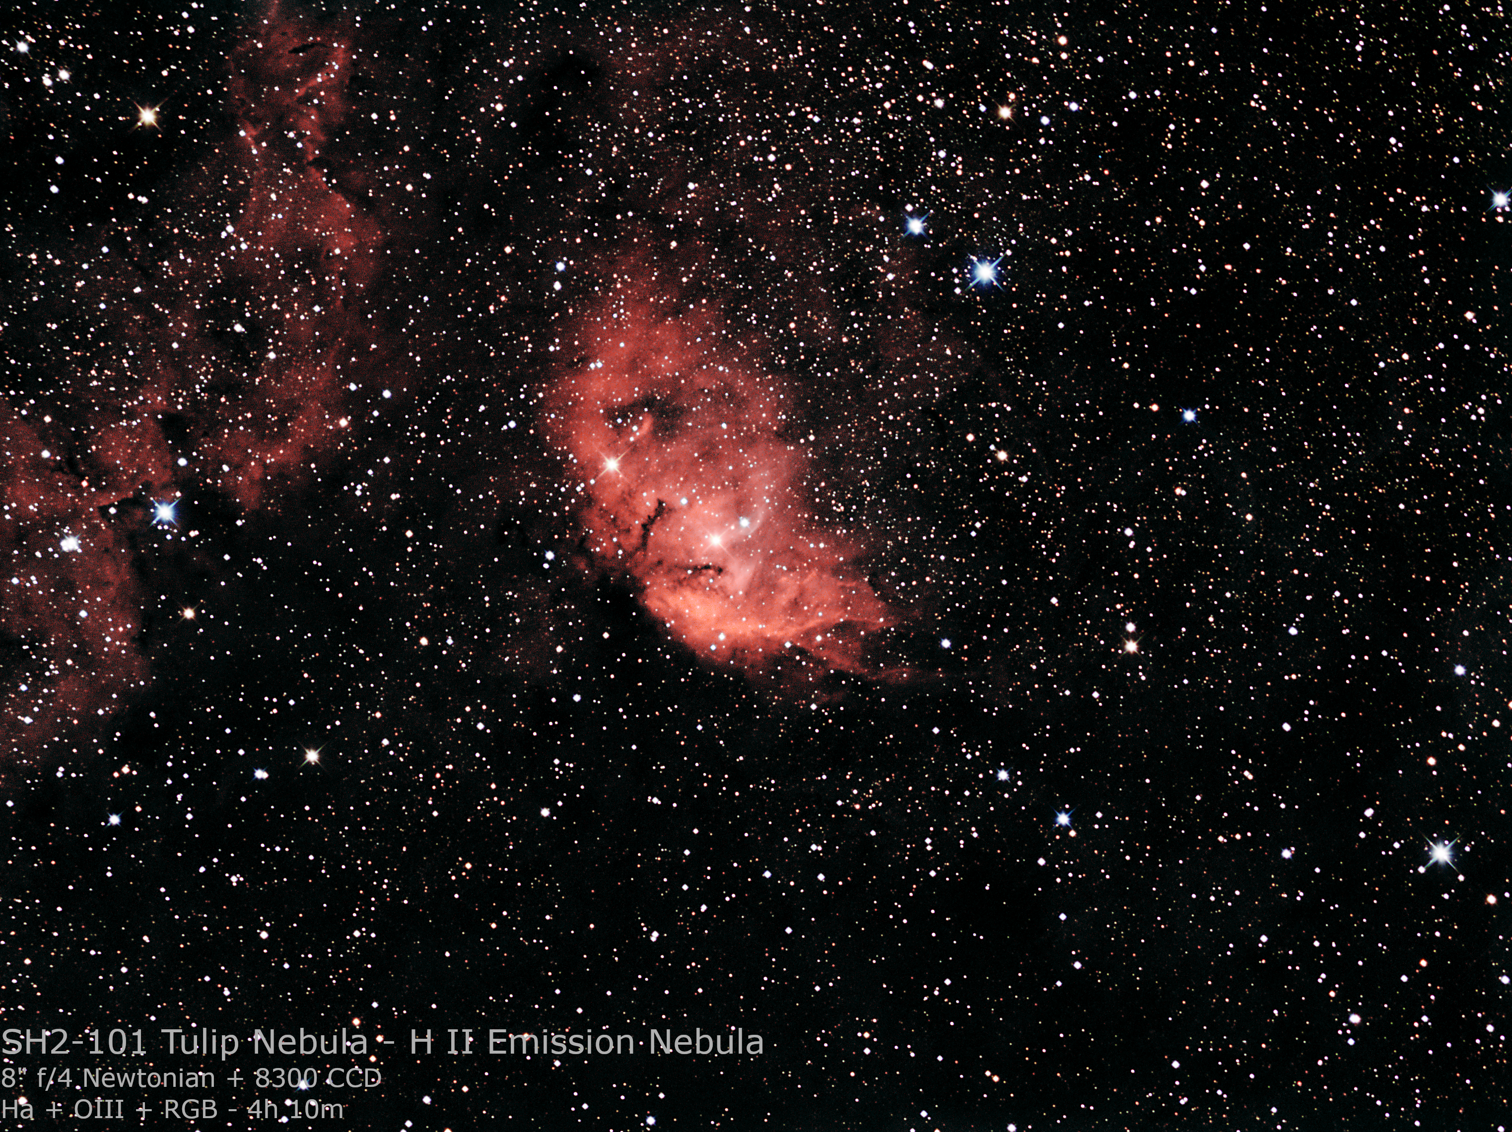

Slide 13
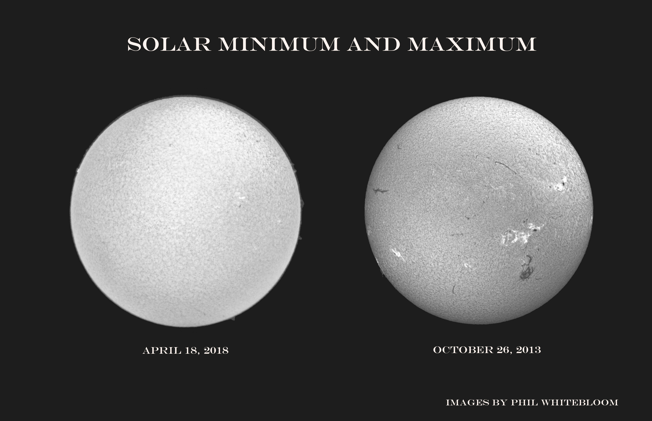

Slide 14
Thank You!
Next month’s meeting is on Thursday, May 17th, 2018 at 7 PM
Dr. Joe Bohannon
HAL Member
Astrophotography from Down Under

